Slide 1
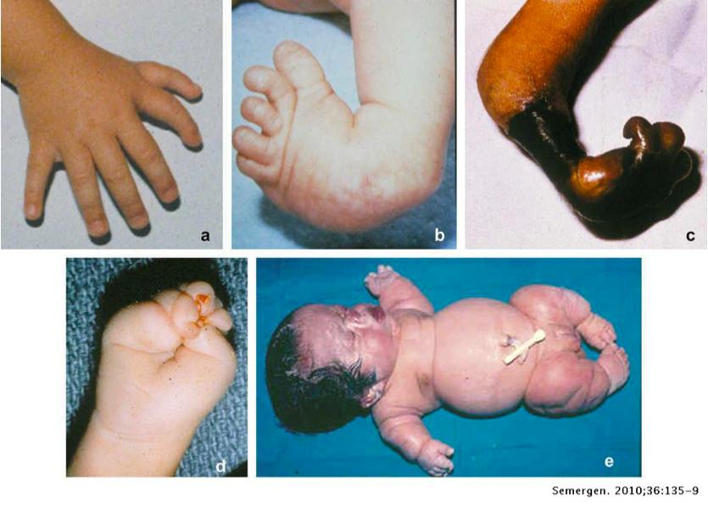
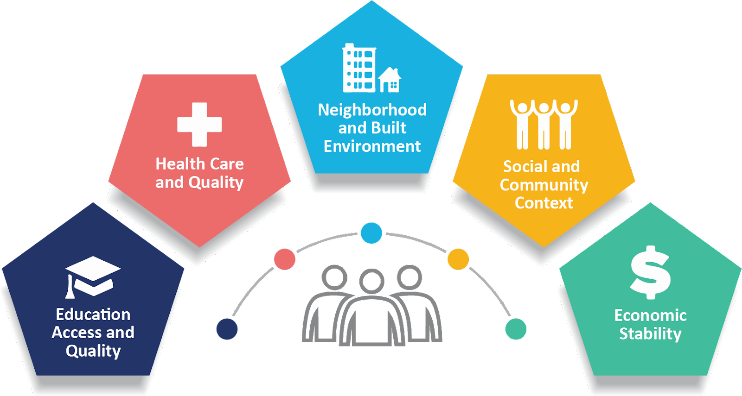
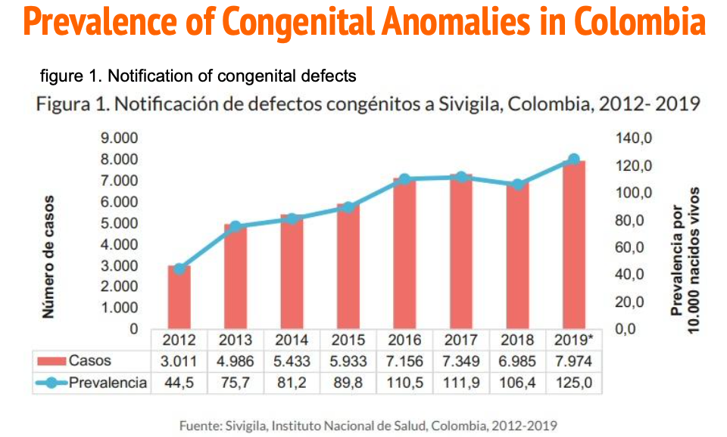
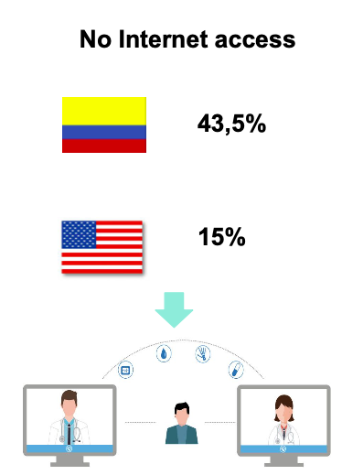
TELEMEDICINE AS TOOL FOR PRIMARY AND SECONDARY PREVENTION OF CONGENITAL ANOMALIES
Authors: Paula Sofía Quintana Prieto 1, María Paz Salazar Ocampo 2, Laura Vanesa Castro Arteaga 1, Jonathan Kertich 3, Miguel Eduardo Forero Corneao 1.
Participating institutions: 1. Medical student - Fundación Universitaria Juan N. Corpas, 2. Medical student - Universidad de Los Andes, 3. Medical student - Des Moines University.
Introduction
Target Population
Justification
Congenital anomalies are also called birth defects. These are structural or functional abnormalities. Such as metabolic disorders, that occur during intrauterine life and are detected during pregnancy, childbirth or later in life.
It is not possible to assign a specific cause to about 50% of congenital anomalies. However, some causes or risk factors have been identified. They include socioeconomic and demographic factors, genetic factors, infections, nutritional status of the mother, and environmental factors.
Pregnant women with poor healthcare access (resources) and low health literacy (education).
In recent years, congenital defects have increased as causes of infant mortality. The worldwide Its prevalence ranges between 2% and 3%. It has been estimated that approximately 3.3 million children under 5 years of age die due to congenital anomalies.
43.5% of Colombian households and 15% of U.S.A households don’t have access to Internet.
Comparable Prevalence
Even though the prevalence of cases are much higher in the US, Colombia has almost the same number of cases in a much lower live birth population.
Objectives and Purpose
Ethical Considerations
Goal 3 “GOOD HEALTH AND WELL-BEING” “By 2030, end preventable deaths of newborns and children under 5 years of age, with all countries seeking to reduce neonatal mortality to at least 12 per 1,000 live births and under-5 mortality to at least minus 25 per 1,000 live births”.
Prevent certain congenital anomalies by educating women of childbearing age.
Improve detection and prevention of risk factors of women of childbearing age.
Use data gathered from detection campaigns to better understand factors surrounding congenital anomalies and their prevention.
Methodology
Expected Results
Establish telemedicine centers (with computers and internet) easily accessible to the population. This will increase engagement by women of childbearing age, and ensure fast and easy access to a health services. These centers should be financed by the government.
Implementation and utilization of telemedicine centers would result in:
1) Decreased incidence of preventable contributors to congenital anomalies, such as the use of medications, micronutrient deficiency, presence of teratogens, among others.
2) Increased detection of risk factors for congenital anomalies.
3) Increased medical education of women of childbearing age and pregnant women
References:
Centers for Disease Control and Prevention. (2020, July 27). Causes of congenital anomalies and classification according to developmental mechanism and clinical presentation. Retrieved from https://www.cdc.gov/ncbddd/birthdefects/surveillancemanual/appendices/appendix-c.html n
2) INSTITUTO NACIONAL DE SALUD SIVIGILA. Base de datos Colombia. Retrieved from http://portalsivigila.ins.gov.co/Paginas/datos.aspx?cod=80
WWW.OIISP.ORG

